Slide 1
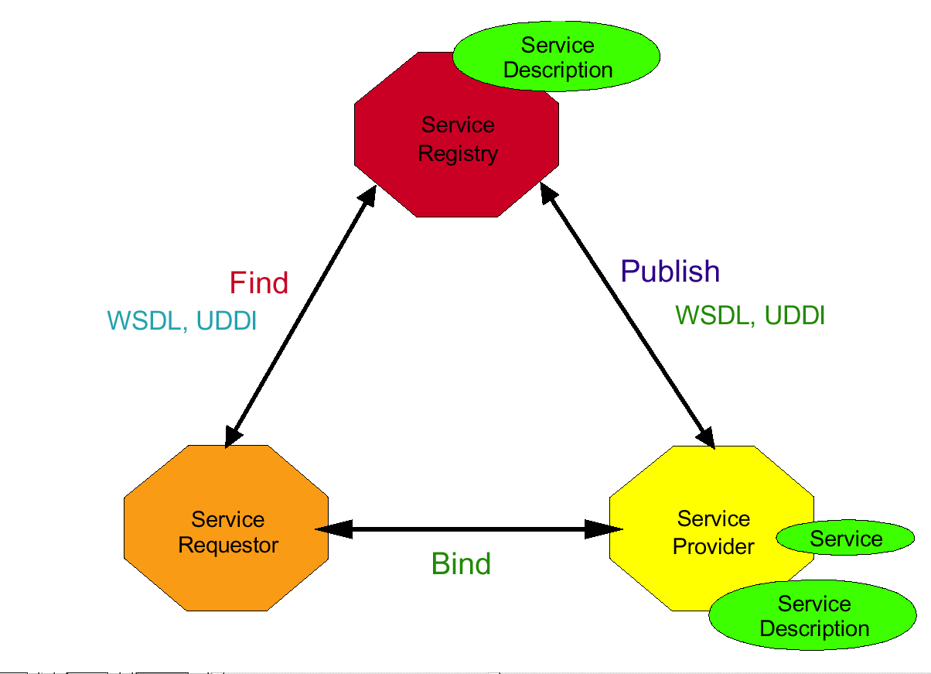
The Java API for XML-Based Web Services

Slide 2
A Web Service example in Java
HTTP Server
Servlet engine (e.g. Apache Tomcat)
Any class
processing
the incoming
requests
(“business logic”
Any class
processing
the incoming
requests
(“business logic”
Any class
processing
the incoming
requests
(“business logic”
Any class
processing
the incoming
requests
(“business logic”
SOAP-aware
Servlet
(e.g. Apache Axis2)
Sending requests, getting results

Slide 3
Java API for XML Web Services
The Java API for XML Web Services (JAX-WS) is a Java programming language API for creating web services.
JAX-WS 2.0 replaced the JAX-RPC API in Java Platform, Enterprise Edition 5. The name change reflected the move away from RPC-style and toward document-style web services.
It is part of the Java EE platform from Sun Microsystems. Like the other Java EE APIs.
JAX-WS uses annotations, to simplify the development and deployment of web service clients and endpoints.
The Reference Implementation of JAX-WS is developed as an open source project and is part of project GlassFish, an open source Java EE application server.
It is called JAX-WS RI (For Reference Implementation).
This Reference Implementation is now part of the Metro distribution (a web service stack).
JAX-WS also is one of the foundations of WSIT.

Slide 4
Building Web Services with JAX-WS
JAX-WS is a technology for building web services and clients that communicate using XML.
In JAX-WS, a remote procedure call is represented by an XML-based protocol such as SOAP. The SOAP specification defines the envelope structure, encoding rules, and conventions for representing remote procedure calls and responses. These calls and responses are transmitted as SOAP messages (XML files) over HTTP.

Slide 5
How It Works: Build time
On the server side, the developer specifies the remote procedures by defining methods in an interface written in the Java programming language. The developer also codes one or more classes that implement those methods.
Client programs are also easy to code. A client creates a proxy (a local object representing the service) and then simply invokes methods on the proxy.

Slide 6
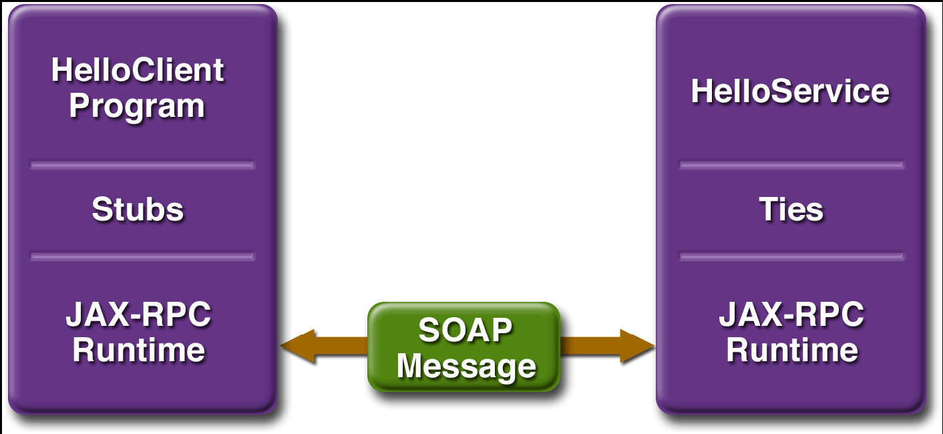
How It Works: Runtime

Slide 7
The Service Endpoint Interface
A service endpoint interface (SEI) is a Java interface that declares the methods that a client can invoke on the service. An SEI is not required when building a JAX-WS endpoint. The web service implementation class implicitly defines a SEI.
You may specify an explicit SEI by adding the endpointInterface element to the WebService annotation in the implementation class. You must then provide a SEI that defines the public methods made available in the endpoint implementation class.

Slide 8
These are the basic steps for creating the web service and client
1. Code the implementation class.
2. Compile the implementation class.
3. Use wsgen to generate the artifacts required to deploy the service.
4. Package the files into a WAR file.
5. Deploy the WAR file. The tie classes (which are used to communicate with clients) are generated by the Application Server during deployment.
6. Code the client class.
7. Use wsimport to generate and compile the stub files.
8. Compile the client class.
9. Run the client

Slide 9
Working from WSDL
<?xml version="1.0" encoding="UTF-8"?>
<definitions name="HelloService“ targetNamespace="http://localhost:8080/axis/services/Hello" xmlns="http://schemas.xmlsoap.org/wsdl/“ xmlns:soap="http://schemas.xmlsoap.org/wsdl/soap/" xmlns:tns=http://localhost:8080/axis/services/Hello” xmlns:xsd="http://www.w3.org/2001/XMLSchema">
<message name="SayHelloRequest"><part name="name" type="xsd:string"/></message>
<message name="SayHelloResponse"><part name="greeting" type="xsd:string"/></message>
<portType name="Hello_PortType">
<operation name="sayHello"><input message="tns:SayHelloRequest"/><output message="tns:SayHelloResponse"/></operation>
</portType>
<binding name="Hello_Binding" type="tns:Hello_PortType">
<soap:binding style="rpc" transport="http://schemas.xmlsoap.org/soap/http"/>
<operation name="sayHello">
<soap:operation soapAction="sayHello"/>
<input><soap:body encodingStyle="http://schemas.xmlsoap.org/soap/encoding/" namespace="urn:examples:helloservice" use="encoded"/></input>
<output><soap:body encodingStyle="http://schemas.xmlsoap.org/soap/encoding/" namespace="urn:examples:helloservice" use="encoded"/></output>
</operation>
</binding>
<service name="Hello_Service">
<documentation>WSDL File for HelloService</documentation>
<port binding="tns:Hello_Binding" name="Hello_Port"><soap:address location="http://localhost:8080/axis/services/Hello"/></port>
</service>
</definitions>

Slide 10
Analysis of the Example
Definition : HelloService
Type : Using built-in data types and they are defined in XMLSchema.
Message :
  sayHelloRequest : name parameter
  sayHelloresponse: greeting return value
Port Type: sayHello operation that consists of a request and response service.
Binding: Direction to use the SOAP HTTP transport protocol.
Service: Service available at http://localhost:8080/axis/services/Hello/.
Port: Associates the binding with the URI http://localhost:8080/axis/services/Hello/ where the running service can be accessed.

Slide 11
Working from Java
package helloservice;
import javax.jws.WebMethod;
import javax.jws.WebService;
@WebService
public class Hello {
private String message = new String("Hello, ");
@WebMethod
public String sayHello(String name) {
return message + name + ".";
}
}

Slide 12
SOAP Messages
<?xml version='1.0' encoding='UTF-8'?>
<soap:Envelope xmlns:xsi='http://www.w3.org/2001/XMLSchema-instance‘ xmlns:xsd='http://www.w3.org/2001/XMLSchema' xmlns:soap='http://schemas.xmlsoap.org/soap/envelope/' xmlns:soapenc='http://schemas.xmlsoap.org/soap/encoding/' soap:encodingStyle='http://schemas.xmlsoap.org/soap/encoding/'>
<soap:Body>
<n:sayHello xmlns:n='http://localhost:8080/axis/services/Hello'>
<name xsi:type='xsd:string'>World</name>
</n:sayHello>
</soap:Body>
</soap:Envelope>
<?xml version='1.0' encoding='UTF-8'?>
<SOAP-ENV:Envelope xmlns:SOAP-ENV='http://schemas.xmlsoap.org/soap/envelope/‘ xmlns:xsi='http://www.w3.org/1999/XMLSchema-instance‘ xmlns:xsd='http://www.w3.org/1999/XMLSchema'>
<SOAP-ENV:Body>
<ns1:sayHelloResponse
xmlns:ns1='http://localhost:8080/axis/services/Hello'
SOAP-ENV:encodingStyle=
'http://schemas.xmlsoap.org/soap/encoding/'>
<return xsi:type='xsd:string'>Hello, World!</return>
</ns1:sayHelloResponse>
</SOAP-ENV:Body>
</SOAP-ENV:Envelope>

Slide 13
RPC and Document Styles
RPC/encoded
RPC/literal
Document/encoded
Document/literal
Document/literal wrapped
public void myMethod(int x, float y);
The style has nothing to do with a programming model. It merely dictates how to translate a WSDL binding to a SOAP message. Nothing more. You can use either style with any programming model.

Slide 14
RPC/encoded
<soap:envelope> <soap:body> <myMethod>
<x xsi:type="xsd:int">5</x>
<y xsi:type="xsd:float">5.0</y>
</myMethod> </soap:body> </soap:envelope>
Strengths
The WSDL is about as straightforward as it's possible for WSDL to be.
The operation name appears in the message, so the receiver has an easy time dispatching this message to the implementation of the operation.
Weaknesses
The type encoding info (such as xsi:type="xsd:int") is usually just overhead which degrades throughput performance.
You cannot easily validate this message since only the <x ...>5</x> and <y ...>5.0</y> lines contain things defined in a schema; the rest of the soap:body contents comes from WSDL definitions.
Although it is legal WSDL, RPC/encoded is not WS-I compliant.

Slide 15
RPC/literal
<soap:envelope> <soap:body> <myMethod>
<x>5</x>
<y>5.0</y>
</myMethod> </soap:body> </soap:envelope>
Strengths
The WSDL is still about as straightforward as it is possible for WSDL to be.
The operation name still appears in the message.
The type encoding info is eliminated.
RPC/literal is WS-I compliant.
Weaknesses
You still cannot easily validate this message since only the <x ...>5</x> and <y ...>5.0</y> lines contain things defined in a schema; the rest of the soap:body contents comes from WSDL definitions.

Slide 16
Document/literal
<soap:envelope> <soap:body>
<xElement>5</xElement>
<yElement>5.0</yElement>
</soap:body> </soap:envelope>
Strengths
There is no type encoding info.
You can finally validate this message with any XML validator. Everything within the soap:body is defined in a schema.
Document/literal is WS-I compliant, but with restrictions.
Weaknesses
The WSDL is getting a bit more complicated. This is a very minor weakness.
The operation name in the SOAP message is lost. Without the name, dispatching can be difficult, and sometimes impossible.
WS-I only allows one child of the soap:body in a SOAP message. As you can see above, this example's soap:body has two children.

Slide 17
Document/literal wrapped
<soap:envelope> <soap:body> <myMethod>
<x>5</x>
<y>5.0</y>
</myMethod> </soap:body> </soap:envelope>
Strengths
There is no type encoding info.
Everything that appears in the soap:body is defined by the schema, so you can easily validate this message.
Once again, you have the method name in the SOAP message.
Document/literal is WS-I compliant, and the wrapped pattern meets the WS-I restriction that the SOAP message's soap:body has only one child.
Weaknesses
The WSDL is even more complicated.

